Slide 1

W4111 – 02: Introduction to Databases
Lecture 3,4: ER Modeling, SQL, Relational
Donald F. Ferguson dff9@Columbia.edu
TRANSCENDING DISCIPLINES, TRANSFORMING LIVES

Slide 2
Today’s Lecture – What You Need for HW 1
Programming and No-Programming HW/Projects Direction
Entity-Relationship Modeling:
Subset of Chapter 6 from recommended textbook.
Slides should be enough and there is a lot of online material.
Crow’s Foot Notation:
Simpler and more compact.
Very similar to what MySQL uses.
Demo of MySQL tools.
Introduction to Some Patterns in SQL DDL
Some Details on SQL DML SELECT.
Interwoven with Some Demos.
2 | W4111_02_S20: Introduction to Databases -- Lecture 3,4

Slide 3

Programming and No-Programming Homework Directions
3 | W4111_02_S20: Introduction to Databases -- Lecture 3,4

Slide 4
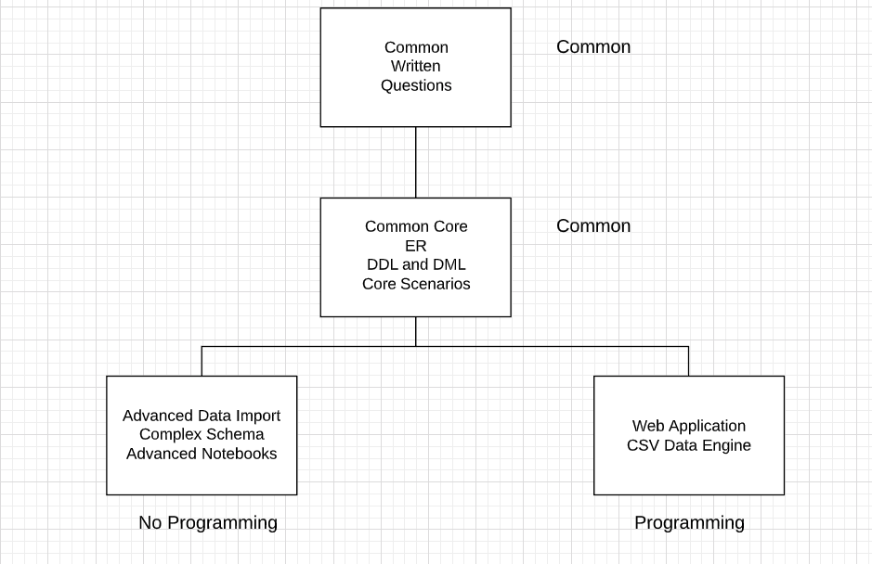
Homework/Project Directions: Programming, No-Programming
4 | W4111_02_S20: Introduction to Databases -- Lecture 3,4

Slide 5
Entity-Relationship Modeling
5 | W4111_02_S20: Introduction to Databases -- Lecture 3,4

Slide 6
Chapter 6: Database Design Using the E-R Model

Slide 7
Outline
Overview of the Design Process
The Entity-Relationship Model
Complex Attributes
Mapping Cardinalities
Primary Key
Removing Redundant Attributes in Entity Sets
Reducing ER Diagrams to Relational Schemas
Extended E-R Features
Entity-Relationship Design Issues
Alternative Notations for Modeling Data
Other Aspects of Database Design
Will cover:
In other lectures.
Or required reading.

Slide 8
Outline
Extended E-R Features
Entity-Relationship Design Issues
Alternative Notations for Modeling Data
Other Aspects of Database Design

Slide 9

Logical – Physical – Conceptual
https://ehikioya.com/conceptual-logical-physical-database-modeling/
https://www.1keydata.com/datawarehousing/data-modeling-levels.html
It is easy to get carried away with modeling. You can spend all your time modeling and not actually build the schema.
We will use the approaches in class.
Mostly to understand concepts and patterns.
https://www.1keydata.com/datawarehousing/data-modeling-levels.html
9 | W4111_02_S20: Introduction to Databases -- Lecture 3,4

Slide 10
Design Phases
Initial phase -- characterize fully the data needs of the prospective database users.
Second phase -- choosing a data model
Applying the concepts of the chosen data model
Translating these requirements into a conceptual schema of the database.
A fully developed conceptual schema indicates the functional requirements of the enterprise.
Describe the kinds of operations (or transactions) that will be performed on the data.

Slide 11
Design Phases (Cont.)
Final Phase -- Moving from an abstract data model to the implementation of the database
Logical Design – Deciding on the database schema. Database design requires that we find a “good” collection of relation schemas.
Business decision – What attributes should we record in the database?
Computer Science decision – What relation schemas should we have and how should the attributes be distributed among the various relation schemas?
Physical Design – Deciding on the physical layout of the database
Notes:
11

Slide 12
Design Alternatives
In designing a database schema, we must ensure that we avoid two major pitfalls:
Redundancy: a bad design may result in repeat information.
Redundant representation of information may lead to data inconsistency among the various copies of information
Incompleteness: a bad design may make certain aspects of the enterprise difficult or impossible to model.
Avoiding bad designs is not enough. There may be a large number of good designs from which we must choose.
Emphasis Added
Notes:
12

Slide 13
Design Approaches
Entity Relationship Model (covered in this chapter)
Models an enterprise as a collection of entities and relationships
Entity: a “thing” or “object” in the enterprise that is distinguishable from other objects
Described by a set of attributes
Relationship: an association among several entities
Represented diagrammatically by an entity-relationship diagram:
Normalization Theory (Chapter 7)
Formalize what designs are bad, and test for them
Notes:
13

Slide 14
Outline of the ER Model

Slide 15
ER model -- Database Modeling
The ER data mode was developed to facilitate database design by allowing specification of an enterprise schema that represents the overall logical structure of a database.
The ER data model employs three basic concepts:
entity sets,
relationship sets,
attributes.
The ER model also has an associated diagrammatic representation, the ER diagram, which can express the overall logical structure of a database graphically.

Slide 16
Entity Sets
An entity is an object that exists and is distinguishable from other objects.
Example: specific person, company, event, plant
An entity set is a set of entities of the same type that share the same properties.
Example: set of all persons, companies, trees, holidays
An entity is represented by a set of attributes; i.e., descriptive properties possessed by all members of an entity set.
Example:
instructor = (ID, name, salary ) course= (course_id, title, credits)
A subset of the attributes form a primary key of the entity set; i.e., uniquely identifying each member of the set.

Slide 17
Entity Sets -- instructor and student

Slide 18

Representing Entity sets in ER Diagram
Entity sets can be represented graphically as follows:
Rectangles represent entity sets.
Attributes listed inside entity rectangle
Underline indicates primary key attributes

Slide 19
Relationship Sets
A relationship is an association among several entities
Example: 44553 (Peltier) advisor 22222 (Einstein) student entity relationship set instructor entity
A relationship set is a mathematical relation among n ≥ 2 entities, each taken from entity sets
{(e₁, e₂, … e_{n}) | e₁ ∈ E₁, e₂ ∈ E₂, …, e_{n} ∈ E_{n}} where (e₁, e₂, …, e_{n}) is a relationship
Example:
(44553,22222) ∈ advisor

Slide 20
Relationship Sets (Cont.)
Example: we define the relationship set advisor to denote the associations between students and the instructors who act as their advisors.
Pictorially, we draw a line between related entities.

Slide 21
Representing Relationship Sets via ER Diagrams
Diamonds represent relationship sets.

Slide 22
Relationship Sets (Cont.)
An attribute can also be associated with a relationship set.
For instance, the advisor relationship set between entity sets instructor and student may have the attribute date which tracks when the student started being associated with the advisor

Slide 23
Relationship Sets with Attributes

Slide 24
Roles
Entity sets of a relationship need not be distinct
Each occurrence of an entity set plays a “role” in the relationship
The labels “course_id” and “prereq_id” are called roles.

Slide 25
Degree of a Relationship Set
Binary relationship
involve two entity sets (or degree two).
most relationship sets in a database system are binary.
Relationships between more than two entity sets are rare. Most relationships are binary. (More on this later.)
Example: students work on research projects under the guidance of an instructor.
relationship proj_guide is a ternary relationship between instructor, student, and project

Slide 26
Non-binary Relationship Sets
Most relationship sets are binary
There are occasions when it is more convenient to represent relationships as non-binary.
E-R Diagram with a Ternary Relationship

Slide 27
Complex Attributes
Attribute types:
Simple and composite attributes.
Single-valued and multivalued attributes
Example: multivalued attribute: phone_numbers
Derived attributes
Can be computed from other attributes
Example: age, given date_of_birth
Domain – the set of permitted values for each attribute

Slide 28
Composite Attributes
Composite attributes allow us to divided attributes into subparts (other attributes).

Slide 29
Representing Complex Attributes in ER Diagram

Slide 30
Mapping Cardinality Constraints
Express the number of entities to which another entity can be associated via a relationship set.
Most useful in describing binary relationship sets.
For a binary relationship set the mapping cardinality must be one of the following types:
One to one
One to many
Many to one
Many to many

Slide 31
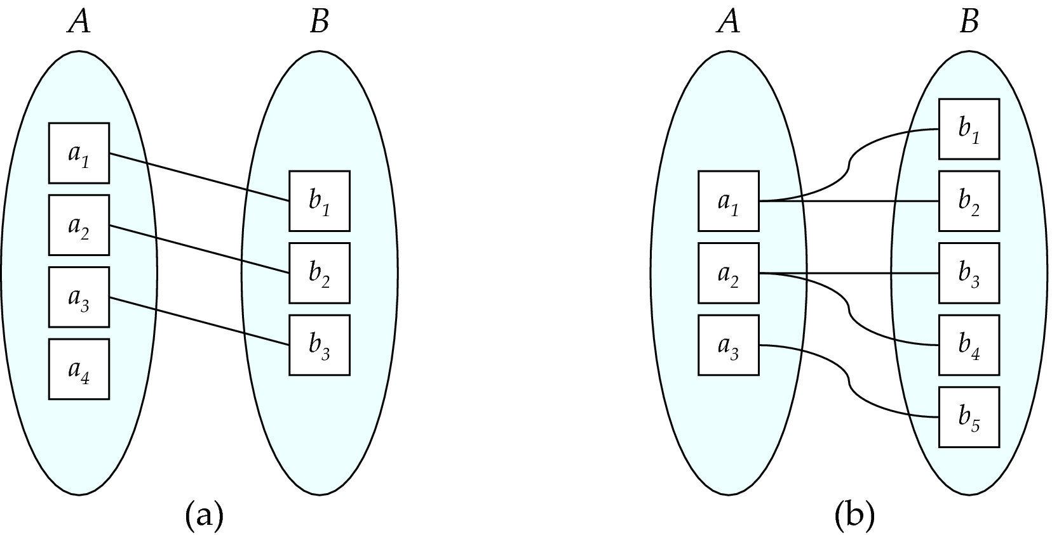
Mapping Cardinalities
One to one
One to many
Note: Some elements in A and B may not be mapped to any
elements in the other set

Slide 32
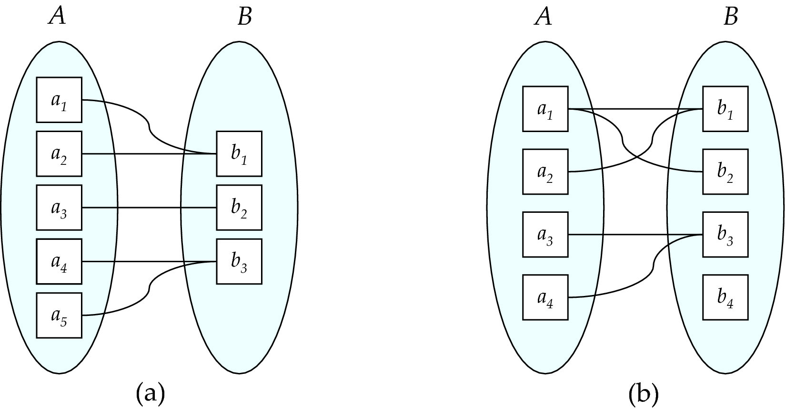
Mapping Cardinalities
Many to one
Many to many
Note: Some elements in A and B may not be mapped to any
elements in the other set

Slide 33
Representing Cardinality Constraints in ER Diagram
We express cardinality constraints by drawing either a directed line (→), signifying “one,” or an undirected line (—), signifying “many,” between the relationship set and the entity set.
One-to-one relationship between an instructor and a student :
A student is associated with at most one instructor via the relationship advisor
A student is associated with at most one department via stud_dept

Slide 34
One-to-Many Relationship
one-to-many relationship between an instructor and a student
an instructor is associated with several (including 0) students via advisor
a student is associated with at most one instructor via advisor,

Slide 35
Many-to-One Relationships
In a many-to-one relationship between an instructor and a student,
an instructor is associated with at most one student via advisor,
and a student is associated with several (including 0) instructors via advisor

Slide 36
Many-to-Many Relationship
An instructor is associated with several (possibly 0) students via advisor
A student is associated with several (possibly 0) instructors via advisor

Slide 37
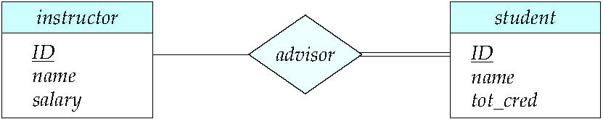
Total and Partial Participation
Total participation (indicated by double line): every entity in the entity set participates in at least one relationship in the relationship set
participation of student in advisor relation is total
every student must have an associated instructor
Partial participation: some entities may not participate in any relationship in the relationship set
Example: participation of instructor in advisor is partial

Slide 38
Primary Key
Primary keys provide a way to specify how entities and relations are distinguished. We will consider:
Entity sets
Relationship sets.
Weak entity sets

Slide 39
Primary key for Entity Sets
By definition, individual entities are distinct.
From database perspective, the differences among them must be expressed in terms of their attributes.
The values of the attribute values of an entity must be such that they can uniquely identify the entity.
No two entities in an entity set are allowed to have exactly the same value for all attributes.
A key for an entity is a set of attributes that suffice to distinguish entities from each other

Slide 40
Primary Key for Relationship Sets
To distinguish among the various relationships of a relationship set we use the individual primary keys of the entities in the relationship set.
Let R be a relationship set involving entity sets E1, E2, .. En
The primary key for R is consists of the union of the primary keys of entity sets E1, E2, ..En
If the relationship set R has attributes a1, a2, .., am associated with it, then the primary key of R also includes the attributes a1, a2, .., am
Example: relationship set “advisor”.
The primary key consists of inrsructor.ID and student.ID
The choice of the primary key for a relationship set depends on the mapping cardinality of the relationship set.

Slide 41
Choice of Primary key for Binary Relationship
Many-to-Many relationships. The preceding union of the primary keys is a minimal superkey and is chosen as the primary key.
One-to-Many relationships . The primary key of the “Many” side is a minimal superkey and is used as the primary key.
Many-to-one relationships. The primary key of the “Many” side is a minimal superkey and is used as the primary key.
One-to-one relationships. The primary key of either one of the participating entity sets forms a minimal superkey, and either one can be chosen as the primary key.

Slide 42
Choice of Primary key for Nonbinary Relationship
If no cardinality constraints are present, the superkey is formed as described earlier. and it is chosen as the primary key.
If there are cardinality constraints are present:
Recall that we permit at most one arrow out of a relationship set.
AVI

Slide 43
Crow’s Foot Notation
43 | W4111_02_S20: Introduction to Databases -- Lecture 3,4

Slide 44
Crow’s Foot Notation
Good intro: https://www.vertabelo.com/blog/crow-s-foot-notation/
Concepts
Levels:
Conceptual
Logical
Physical
Two directions:
To-Down
Bottom-Up
Meet-in-the-Middle
The concepts are general and apply to all modeling, not just Crow’s Feet.
44 | W4111_02_S20: Introduction to Databases -- Lecture 3,4

Slide 45
Switch to Demos
MySQL: Bottom-Up applied to New Book schema.
Lucidchart:
Conceptual → Logical → Physical
Applied to: Game of Thrones Data
The No-Programming Track will likely use this data.
We will decide after completion of homework 1.
Write the corresponding SQL.
45 | W4111_02_S20: Introduction to Databases -- Lecture 3,4

Slide 46

Example I – IMDB
46 | W4111_02_S20: Introduction to Databases -- Lecture 1

Slide 47
SQL Details 1
47 | W4111_02_S20: Introduction to Databases -- Lecture 3,4

Slide 48
Basic Query Structure
A typical SQL query has the form: select A₁, A₂, ..., A_{n} from r₁, r₂, ..., r_{m} where P
A_{i} represents an attribute
R_{i} represents a relation
P is a predicate.
The result of an SQL query is a relation.
Notes:
2

Slide 49
The select Clause
The select clause lists the attributes desired in the result of a query
corresponds to the projection operation of the relational algebra
Example: find the names of all instructors: select name from instructor
NOTE: SQL names are case insensitive (i.e., you may use upper- or lower-case letters.)
E.g., Name ≡ NAME ≡ name
Some people use upper case wherever we use bold font.
Notes:
3

Slide 50
The select Clause (Cont.)
SQL allows duplicates in relations as well as in query results.
To force the elimination of duplicates, insert the keyword distinct after select.
Find the department names of all instructors, and remove duplicates
select distinct dept_name from instructor
The keyword all specifies that duplicates should not be removed.
select all dept_name from instructor
Notes:
4

Slide 51
The select Clause (Cont.)
An asterisk in the select clause denotes “all attributes”
select * from instructor
An attribute can be a literal with no from clause
select '437'
Results is a table with one column and a single row with value “437”
Can give the column a name using:
select '437' as FOO
An attribute can be a literal with from clause
select 'A' from instructor
Result is a table with one column and N rows (number of tuples in the instructors table), each row with value “A”
Notes:
5

Slide 52
The select Clause (Cont.)
The select clause can contain arithmetic expressions involving the operation, +, –, ∗, and /, and operating on constants or attributes of tuples.
The query:
select ID, name, salary/12 from instructor
would return a relation that is the same as the instructor relation, except that the value of the attribute salary is divided by 12.
Can rename “salary/12” using the as clause:
select ID, name, salary/12 as monthly_salary
Notes:
5

Slide 53
The where Clause
The where clause specifies conditions that the result must satisfy
Corresponds to the selection predicate of the relational algebra.
To find all instructors in Comp. Sci. dept
select name from instructor where dept_name = 'Comp. Sci.'
SQL allows the use of the logical connectives and, or, and not
The operands of the logical connectives can be expressions involving the comparison operators <, <=, >, >=, =, and <>.
Comparisons can be applied to results of arithmetic expressions
To find all instructors in Comp. Sci. dept with salary > 80000
select name from instructor where dept_name = 'Comp. Sci.' and salary > 80000
Notes:
6

Slide 54
The from Clause
The from clause lists the relations involved in the query
Corresponds to the Cartesian product operation of the relational algebra.
Find the Cartesian product instructor X teaches
select ∗ from instructor, teaches
generates every possible instructor – teaches pair, with all attributes from both relations.
For common attributes (e.g., ID), the attributes in the resulting table are renamed using the relation name (e.g., instructor.ID)
Cartesian product not very useful directly, but useful combined with where-clause condition (selection operation in relational algebra).
Notes:
8

Slide 55
Examples
Find the names of all instructors who have taught some course and the course_id
select name, course_id from instructor , teaches where instructor.ID = teaches.ID
Find the names of all instructors in the Art department who have taught some course and the course_id
select name, course_id from instructor , teaches where instructor.ID = teaches.ID and instructor. dept_name = 'Art'
Notes:
9

Slide 56
The Rename Operation
The SQL allows renaming relations and attributes using the as clause:
old-name as new-name
Find the names of all instructors who have a higher salary than some instructor in 'Comp. Sci'.
select distinct T.name from instructor as T, instructor as S where T.salary > S.salary and S.dept_name = 'Comp. Sci.’
Keyword as is optional and may be omitted instructor as T ≡ instructor T
Notes:
9

Slide 57
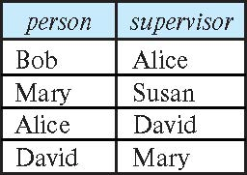
Self Join Example
Relation emp-super
Find the supervisor of “Bob”
Find the supervisor of the supervisor of “Bob”
Can you find ALL the supervisors (direct and indirect) of “Bob”?
Notes:
9

Slide 58
String Operations
SQL includes a string-matching operator for comparisons on character strings. The operator like uses patterns that are described using two special characters:
percent ( % ). The % character matches any substring.
underscore ( _ ). The _ character matches any character.
Find the names of all instructors whose name includes the substring “dar”.
select name from instructor where name like '%dar%'
Match the string “100%”
like '100 \%' escape '\'
in that above we use backslash (\) as the escape character.

Slide 59
String Operations (Cont.)
Patterns are case sensitive.
Pattern matching examples:
'Intro%' matches any string beginning with “Intro”.
'%Comp%' matches any string containing “Comp” as a substring.
'_ _ _' matches any string of exactly three characters.
'_ _ _ %' matches any string of at least three characters.
SQL supports a variety of string operations such as
concatenation (using “||”)
converting from upper to lower case (and vice versa)
finding string length, extracting substrings, etc.

Slide 60
Ordering the Display of Tuples
List in alphabetic order the names of all instructors
select distinct name from instructor order by name
We may specify desc for descending order or asc for ascending order, for each attribute; ascending order is the default.
Example: order by name desc
Can sort on multiple attributes
Example: order by dept_name, name

Slide 61
Where Clause Predicates
SQL includes a between comparison operator
Example: Find the names of all instructors with salary between $90,000 and $100,000 (that is, ≥ $90,000 and ≤ $100,000)
select name from instructor where salary between 90000 and 100000
Tuple comparison
select name, course_id from instructor, teaches where (instructor.ID, dept_name) = (teaches.ID, 'Biology');
Notes:
7

Slide 62
Null Values
It is possible for tuples to have a null value, denoted by null, for some of their attributes
null signifies an unknown value or that a value does not exist.
The result of any arithmetic expression involving null is null
Example: 5 + null returns null
The predicate is null can be used to check for null values.
Example: Find all instructors whose salary is null.
select name from instructor where salary is null
The predicate is not null succeeds if the value on which it is applied is not null.

Slide 63
Null Values (Cont.)
SQL treats as unknown the result of any comparison involving a null value (other than predicates is null and is not null).
Example: 5 < null or null <> null or null = null
The predicate in a where clause can involve Boolean operations (and, or, not); thus the definitions of the Boolean operations need to be extended to deal with the value unknown.
and : (true and unknown) = unknown, (false and unknown) = false, (unknown and unknown) = unknown
or: (unknown or true) = true, (unknown or false) = unknown (unknown or unknown) = unknown
Result of where clause predicate is treated as false if it evaluates to unknown

Slide 64
Aggregate Functions
These functions operate on the multiset of values of a column of a relation, and return a value
avg: average value min: minimum value max: maximum value sum: sum of values count: number of values

Slide 65
Aggregate Functions Examples
Find the average salary of instructors in the Computer Science department
select avg (salary) from instructor where dept_name= 'Comp. Sci.';
Find the total number of instructors who teach a course in the Spring 2018 semester
select count (distinct ID) from teaches where semester = 'Spring' and year = 2018;
Find the number of tuples in the course relation
select count (*) from course;

Slide 66
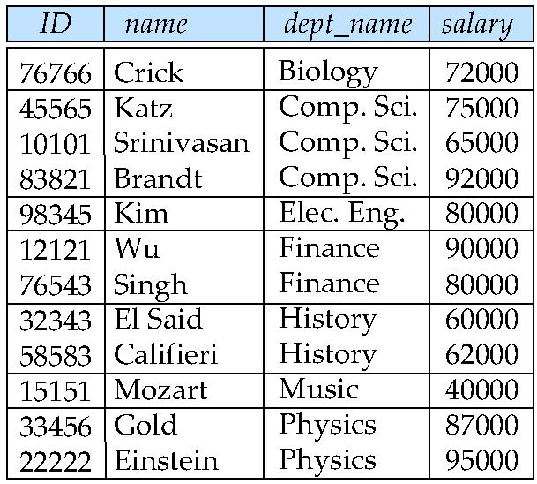
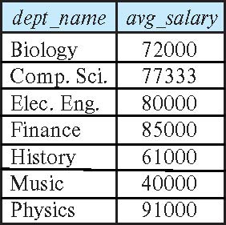
Aggregate Functions – Group By
Find the average salary of instructors in each department
select dept_name, avg (salary) as avg_salary from instructor group by dept_name;

Slide 67
Aggregation (Cont.)
Attributes in select clause outside of aggregate functions must appear in group by list
/* erroneous query */ select dept_name, ID, avg (salary) from instructor group by dept_name;

Slide 68
Aggregate Functions – Having Clause
Find the names and average salaries of all departments whose average salary is greater than 42000
Note: predicates in the having clause are applied after the formation of groups whereas predicates in the where clause are applied before forming groups
select dept_name, avg (salary) as avg_salary
from instructor
group by dept_name
having avg (salary) > 42000;

Slide 69
Nested Subqueries
SQL provides a mechanism for the nesting of subqueries. A subquery is a select-from-where expression that is nested within another query.
The nesting can be done in the following SQL query select A₁, A₂, ..., A_{n} from r₁, r₂, ..., r_{m} where P
as follows:
From clause: r_{i} can be replaced by any valid subquery
Where clause: P can be replaced with an expression of the form:
B <operation> (subquery)
B is an attribute and <operation> to be defined later.
Select clause:
A_{i} can be replaced be a subquery that generates a single value.

Slide 70
Use of “exists” Clause
Yet another way of specifying the query “Find all courses taught in both the Fall 2017 semester and in the Spring 2018 semester”
select course_id from section as S where semester = 'Fall' and year = 2017 and exists (select * from section as T where semester = 'Spring' and year= 2018 and S.course_id = T.course_id);
Correlation name – variable S in the outer query
Correlated subquery – the inner query

Slide 71
Use of “not exists” Clause
Find all students who have taken all courses offered in the Biology department.
Note that X – Y = Ø ⇔ X ⊆ Y
Note: Cannot write this query using = all and its variants
select distinct S.ID, S.name
from student as S
where not exists ( (select course_id
from course
where dept_name = 'Biology')
except
(select T.course_id
from takes as T
where S.ID = T.ID));
First nested query lists all courses offered in Biology
Second nested query lists all courses a particular student took

Slide 72
Test for Absence of Duplicate Tuples
The unique construct tests whether a subquery has any duplicate tuples in its result.
The unique construct evaluates to “true” if a given subquery contains no duplicates .
Find all courses that were offered at most once in 2017
select T.course_id from course as T where unique ( select R.course_id from section as R where T.course_id= R.course_id and R.year = 2017);

Slide 73
Subqueries in the From Clause

Slide 74
Subqueries in the Form Clause
SQL allows a subquery expression to be used in the from clause
Find the average instructors’ salaries of those departments where the average salary is greater than $42,000.”
select dept_name, avg_salary from ( select dept_name, avg (salary) as avg_salary from instructor group by dept_name) where avg_salary > 42000;
Note that we do not need to use the having clause
Another way to write above query
select dept_name, avg_salary from ( select dept_name, avg (salary) from instructor group by dept_name)
as dept_avg (dept_name, avg_salary)
where avg_salary > 42000;

Slide 75
With Clause
The with clause provides a way of defining a temporary relation whose definition is available only to the query in which the with clause occurs.
Find all departments with the maximum budget with max_budget (value) as (select max(budget) from department) select department.name from department, max_budget where department.budget = max_budget.value;

Slide 76
Complex Queries using With Clause
Find all departments where the total salary is greater than the average of the total salary at all departments
with dept _total (dept_name, value) as
(select dept_name, sum(salary)
from instructor
group by dept_name),
dept_total_avg(value) as
(select avg(value)
from dept_total)
select dept_name
from dept_total, dept_total_avg
where dept_total.value > dept_total_avg.value;

Slide 77
Scalar Subquery
Scalar subquery is one which is used where a single value is expected
List all departments along with the number of instructors in each department
select dept_name, ( select count(*) from instructor where department.dept_name = instructor.dept_name) as num_instructors from department;
Runtime error if subquery returns more than one result tuple

Slide 78
Joined Relations
Join operations take two relations and return as a result another relation.
A join operation is a Cartesian product which requires that tuples in the two relations match (under some condition). It also specifies the attributes that are present in the result of the join
The join operations are typically used as subquery expressions in the from clause
Three types of joins:
Natural join
Inner join
Outer join

Slide 79
Natural Join in SQL
Natural join matches tuples with the same values for all common attributes, and retains only one copy of each common column.
List the names of instructors along with the course ID of the courses that they taught
select name, course_id from students, takes where student.ID = takes.ID;
Same query in SQL with “natural join” construct
select name, course_id from student natural join takes;

Slide 80
Natural Join in SQL (Cont.)
The from clause can have multiple relations combined using natural join:
select A₁, A₂, … A_{n} from r₁ natural join r₂ natural join .. natural join r_{n} where P ;

Slide 81
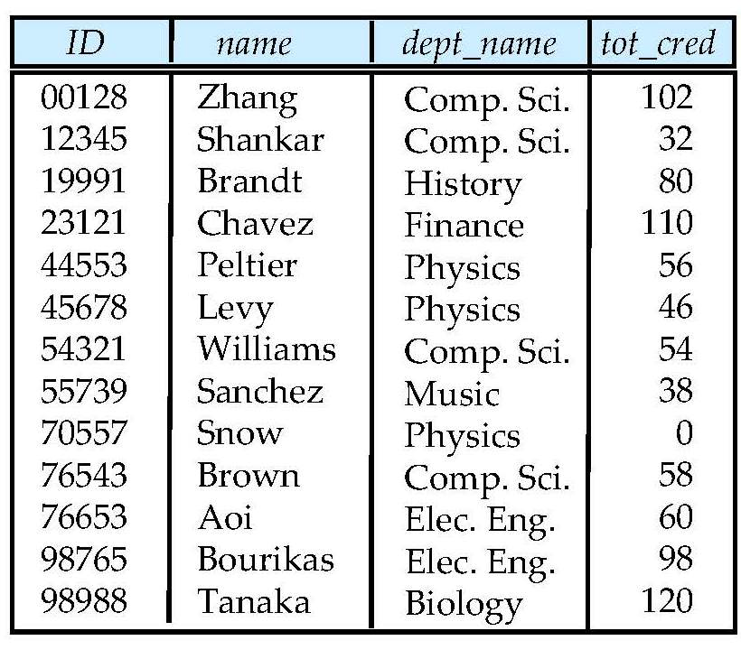
Student Relation

Slide 82
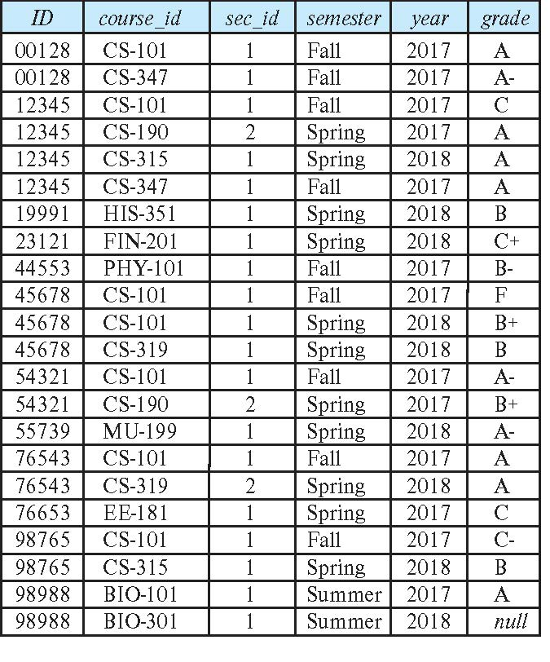
Takes Relation

Slide 83
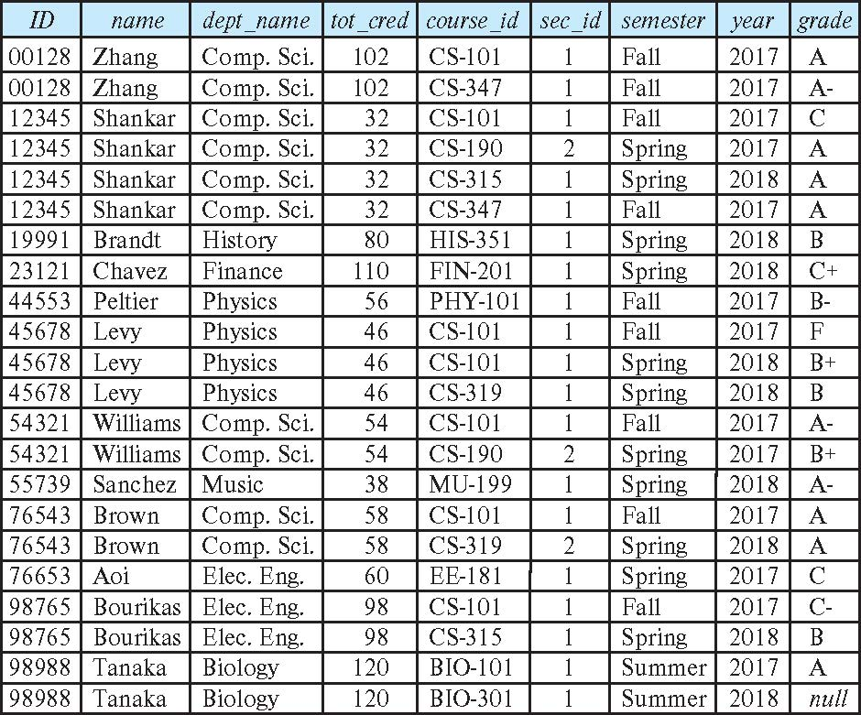
student natural join takes

Slide 84
Dangerous in Natural Join
Beware of unrelated attributes with same name which get equated incorrectly
Example -- List the names of students instructors along with the titles of courses that they have taken
Correct version
select name, title from student natural join takes, course where takes.course_id = course.course_id;
Incorrect version
select name, title from student natural join takes natural join course;
This query omits all (student name, course title) pairs where the student takes a course in a department other than the student's own department.
The correct version (above), correctly outputs such pairs.

Slide 85
Natural Join with Using Clause
To avoid the danger of equating attributes erroneously, we can use the “using” construct that allows us to specify exactly which columns should be equated.
Query example
select name, title from (student natural join takes) join course using (course_id)

Slide 86
Join Condition
The on condition allows a general predicate over the relations being joined
This predicate is written like a where clause predicate except for the use of the keyword on
Query example
select * from student join takes on student_ID = takes_ID
The on condition above specifies that a tuple from student matches a tuple from takes if their ID values are equal.
Equivalent to:
select * from student , takes where student_ID = takes_ID

Slide 87
Join Condition (Cont.)
The on condition allows a general predicate over the relations being joined.
This predicate is written like a where clause predicate except for the use of the keyword on.
Query example
select * from student join takes on student_ID = takes_ID
The on condition above specifies that a tuple from student matches a tuple from takes if their ID values are equal.
Equivalent to:
select * from student , takes where student_ID = takes_ID

Slide 88
Outer Join
An extension of the join operation that avoids loss of information.
Computes the join and then adds tuples form one relation that does not match tuples in the other relation to the result of the join.
Uses null values.
Three forms of outer join:
left outer join
right outer join
full outer join

Slide 89
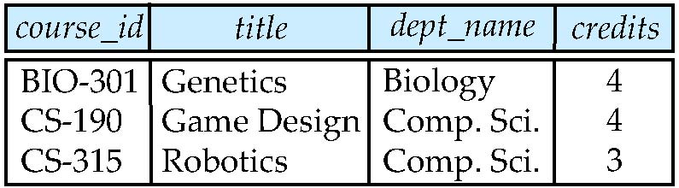
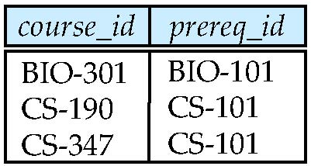
Outer Join Examples
Relation course
Relation prereq
Observe that
course information is missing CS-437
prereq information is missing CS-315
x

Slide 90
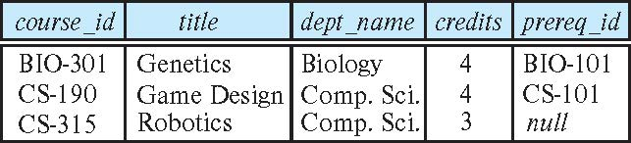
Left Outer Join
course natural left outer join prereq
In relational algebra: course ⟕ prereq

Slide 91
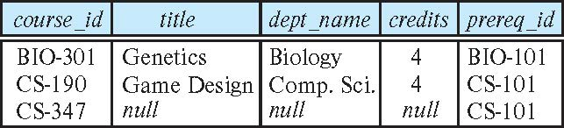
Right Outer Join
course natural right outer join prereq
In relational algebra: course ⟖ prereq

Slide 92
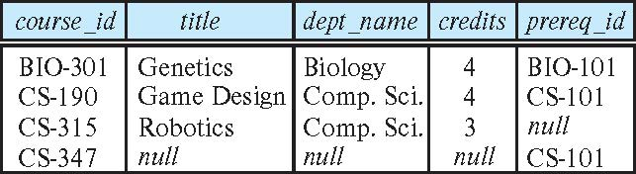
Full Outer Join
course natural full outer join prereq
In relational algebra: course ⟗ prereq

Slide 93
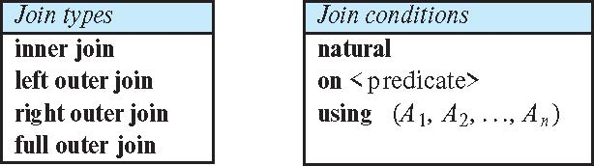
Joined Types and Conditions
Join operations take two relations and return as a result another relation.
These additional operations are typically used as subquery expressions in the from clause
Join condition – defines which tuples in the two relations match.
Join type – defines how tuples in each relation that do not match any tuple in the other relation (based on the join condition) are treated.

Slide 94
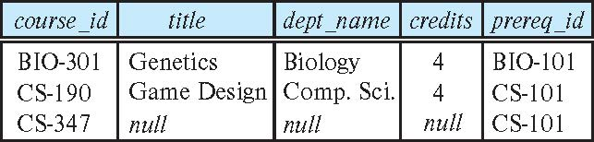
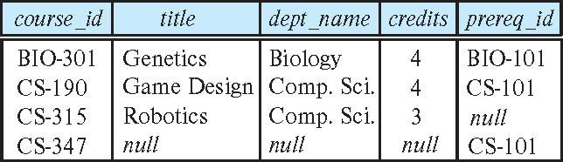
Joined Relations – Examples
course natural right outer join prereq
course full outer join prereq using (course_id)

Slide 95
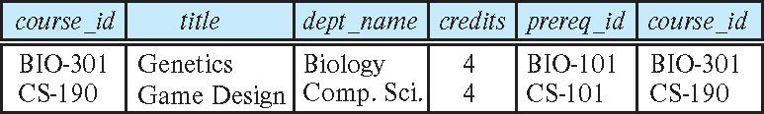
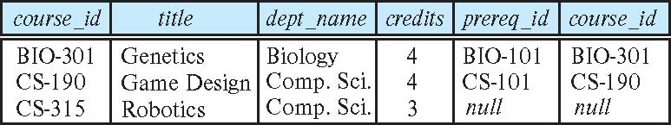
Joined Relations – Examples
course inner join prereq on course.course_id = prereq.course_id
What is the difference between the above, and a natural join?
course left outer join prereq on course.course_id = prereq.course_id

Slide 96
Joined Relations – Examples
course natural right outer join prereq
course full outer join prereq using (course_id)

